Slide 1
Coursera Capstone Project The Battle of Neighborhoods Halal restaurant in New York city
By: Maryam Amini

Slide 3
Introduction
New York City's demographics show that it is a large and ethnically diverse metropolis. It is the largest city in the United States with a long history of international immigration. New York City was home to over 8.3 million people in 2019, accounting for over 40% of the population of New York State and a slightly lower percentage of the New York metropolitan area, home to approximately 23.6 million. Over the last decade the city has been growing faster than the region. The New York region continues to be by far the leading metropolitan gateway for legal immigrants admitted into the United States.
Around 768,767 Muslims live in New York City as of 2016, making up about 8.96% of the city's total population of 8,583,000. Approximately 22.3% of America's Muslims live in New York City, and the Muslim community is rapidly growing on account of immigration, reproduction, and conversion. As a requirement of their religion, Muslims eat Halal food.
So, in this project, I will list and visualize all major parts of New York City that has great Halal restaurants.

Slide 4
Data
In this project I will use the following data :
New York City data that contains list Boroughs, Neighborhoods along with their latitude and longitude. Data source : https://cocl.us/new_york_dataset Description : This data set contains the required information. And we will use this data set to explore various neighborhoods of new york city.
Halal resturants in each neighborhood of new york city. Data source : Fousquare API Description : By using this api we will get all the venues in each neighborhood. We can filter these venues to get only Halal resturants.
GeoSpace data Data source : https://data.cityofnewyork.us/City-Government/Borough-Boundaries/tqmj-j8zm Description : By using this geo space data we will get the New york Borough boundaries that will help us visualize choropleth map.

Slide 5
Approach
Collect the new york city data from https://cocl.us/new_york_dataset
Using FourSquare API we will find all venues for each neighborhood.
Filter out all venues that are Halal Resturants.
Find rating , tips and like count for each Halal Resturants using FourSquare API.
Using rating for each resturant , we will sort that data.
Visualize the Ranking of neighborhoods using folium library(python)

Slide 6
Questions that can be asked using the above-mentioned datasets
What is best location in New York City for Halal foods?
Which areas have potential Halal Restaurant Market?
Which all areas lack Halal Restaurants?
Which is the best place to stay if I prefer Halal foods?
Analysis
We will import the required libraries for python.
pandas and numpy for handling data.
request module for using FourSquare API.
geopy to get co-ordinates of City of New York.
folium to visualize the results on a map

Slide 7


Slide 8
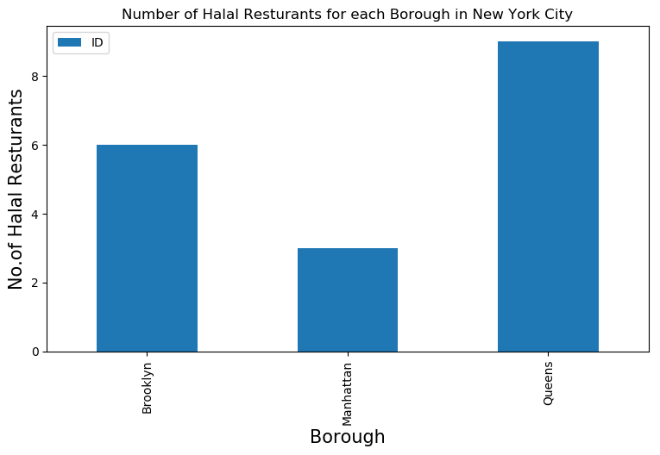
Queens has the highest number of Halal restaurant in New York city’s borough

Slide 9
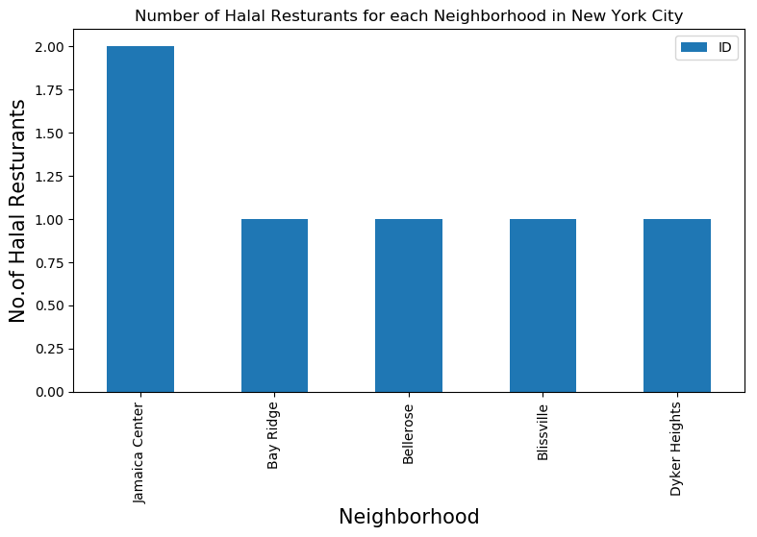
Jamaica Center has the highest number of Halal restaurant in New York city’s neighborhoods.

Slide 10
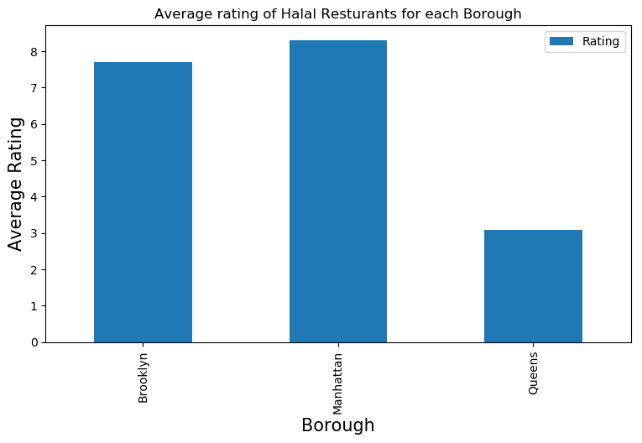
Manhattan has the highest average rating for Halal restaurant.

Slide 11
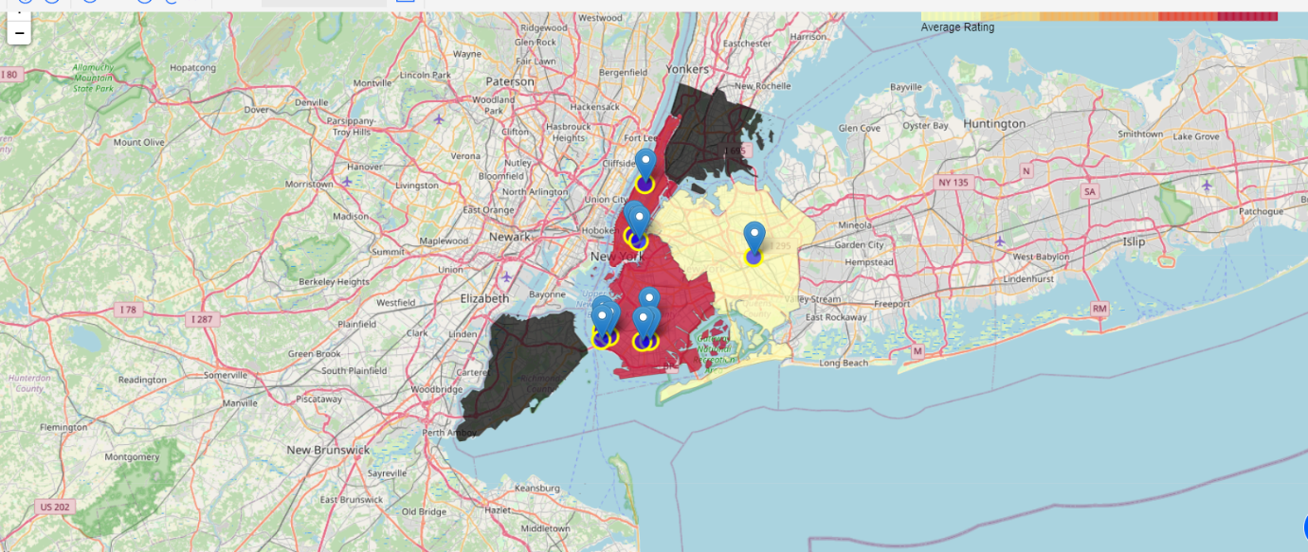
Best neighborhoods in New York that has highest average rating for Indian Restaurants and Borough Choropleth map based on average rating of Indian Restaurants.

Slide 12
Conclusion
Gramercy (Manhattan), Stuyvesant Town (Manhattan), Manhattan Valley(Manhattan Valley) are some of the best neighborhoods for Halal cuisine.
Manhattan have potential Halal Restaurant Market.
Queens ranks last in average rating of Halal Restaurants.
Manhattan is the best place to stay if you prefer Halal Cuisine.
Limitations
The ranking is purely on basis of rating of restaurants
The accuracy of data depends purely depends on the data provided by FourSquare.

